Slide 1
Hypertext Transfer Protocol
(HTTP)

Slide 2
Contents
HTTP and Client-Server model
DNS and URL
HTTP Request and response
Character encoding
Media type

Slide 3
HTTP
HTTP = Hypertext Transfer Protocol
  Application-level protocol for distributed, collaborative, hypermedia information systems.
  Used for retrieving inter-linked resources led to the establishment of the World Wide Web.
  HTTP is a request/response standard of a client and a server.
  Client is the end-user using web browser
  Server is the web site.
Between client and server there may be several intermediaries: proxies, gateways, and tunnels.
Typically, an HTTP client initiates a request to server over TCP
An HTTP server listens at a particular port (80 by default) waits for the request messages from clients.
Standardization: RFC2616 (HTTP 1.1):
http://www.w3.org/Protocols/rfc2616/rfc2616.html

Slide 4
Examples of Web server and client
Web server
  IIS: windows
  Apache HTTP server (Apache): windows, linux
Web client (Browser)
  Internet Explorer:
    Free with Windows license, started in 1995
    Support Windows
  Mozilla Firefox from Mozilla Corporation
    free browser,
    Support: Linux, Mac OS X, Microsoft Windows, and many other Unix-like operating system
  Safari: developed by Apple Inc.
    Support Mac OS, Windows, iPhone OS
  Chrome: from Google
    Free
    Support

Slide 5
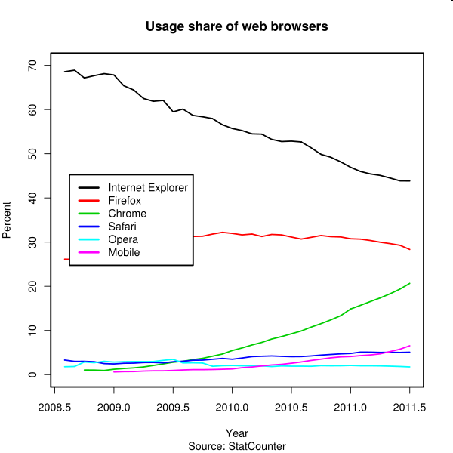
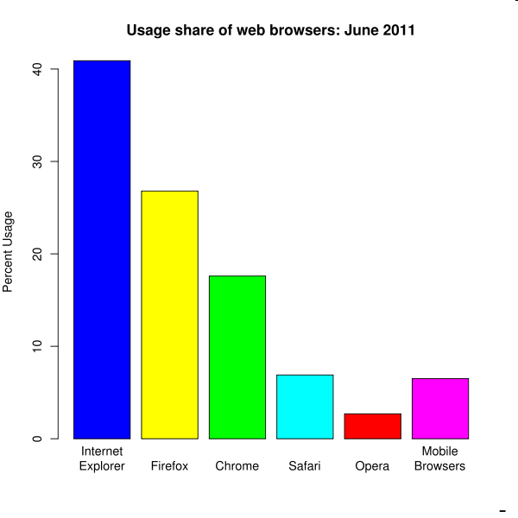
Usage share of web browsers
Wikipedia: http://en.wikipedia.org/wiki/Usage_share_of_web_browsers

Slide 6

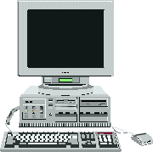
Server Client model
Server client model of Web system
HTTP protocol between Client, Server
Web Server
Store webpage,
Process web request
2
Return HTML document
1
3
Browser display the web page
Request a web page
User (Web Client)

Slide 7
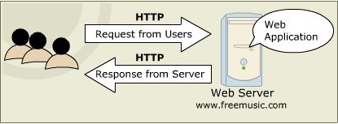
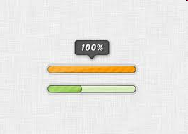

HTTP request and response
How to display download progress bar for 1 HTTP request/response?

Slide 8
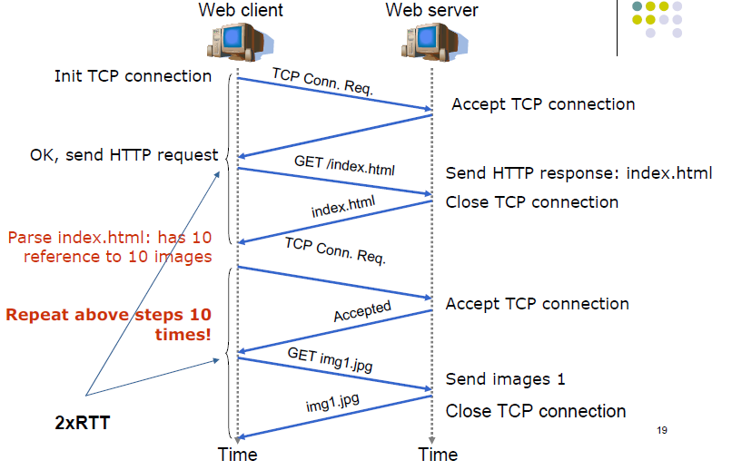
HTTP request and response v.1.0

Slide 9
HTTP request and response
Procedure:
  HTTP Client (Web Browsers) opens the connection
  HTTP Client sends the request message to an HTTP server asking for resource.
  The server returns the response message with the request resource.
  Once the resource is delivered, Server closes the connection.
HTTP doesn’t store any connection information and ➔ stateless protocol.
In HTTP Connection last for only one transaction. A transaction consists a of several request-response pairs.
The default port is 80.

Slide 10
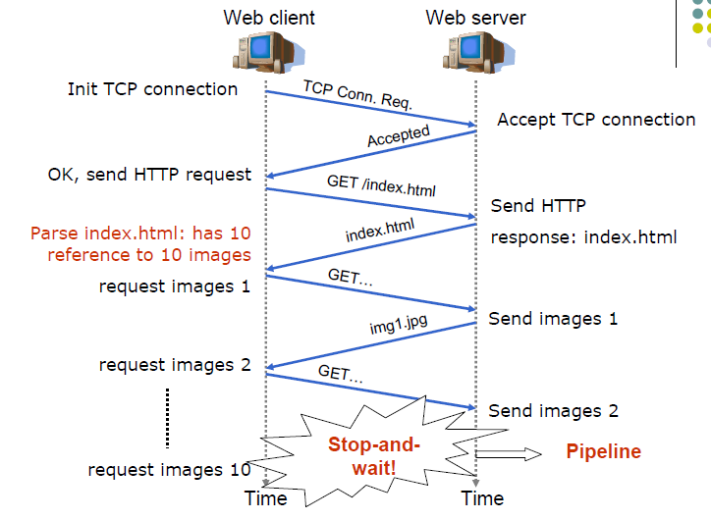
HTTP request and response v.1.1

Slide 11
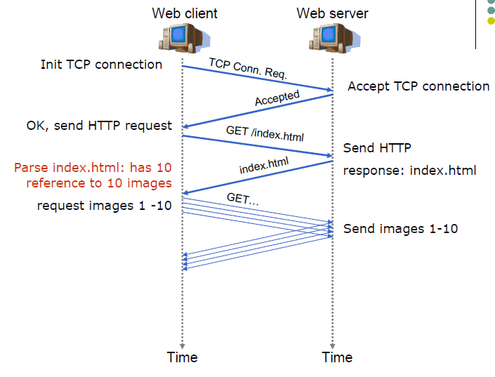
HTTP request and response v.1.1 pipeline

Slide 12
HTTP Message Structure
An initial line CRLF
Zero or more header lines CRLF
A blank line ie. a CRLF
An optional message body like file, query data or query output.

Slide 13
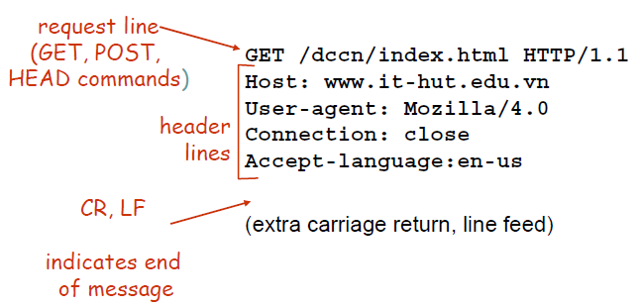
HTTP Request Message

Slide 14
HTTP Request Message: initial line
Initial line has three parts, separated by spaces:
  An HTTP Method Name
  The local path of the requested resource.
  The version of HTTP being used.
Example of initial line:
Methods: GET, POST
The HTTP version always takes the form "HTTP/x.x", uppercase.
GET /path/to/file/index.html HTTP/1.0
Method
URI
HTTP version

Slide 15
GET and POST methods
GET method used for getting information:
  document,
  a simple database query
Parameter of GET is seen in the URL
  Ex: http://www.google.co.uk/search?hl=en&q=java&meta=
POST method is used when submitting information
  credit card number,
  information to be saved in the database.
  Data is included in the body of the request
Data send using POST is not visible to the client and there is not limit on amount of data being sent.

Slide 16
HTTP Response Message: initial line
The initial response line, called the status line, has three parts separated by spaces:
  The version of HTTP being used.
  A response status code that gives the result of the request.
  An English reason phrase describing the status code.
Examples:
  HTTP/1.0 200 OK
  HTTP/1.0 404 Not Found

Slide 17
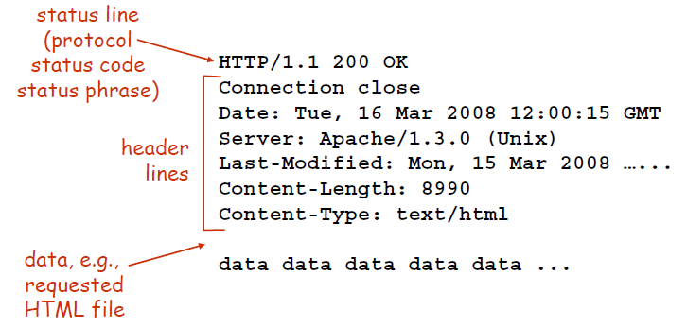
HTTP Response Message

Slide 18
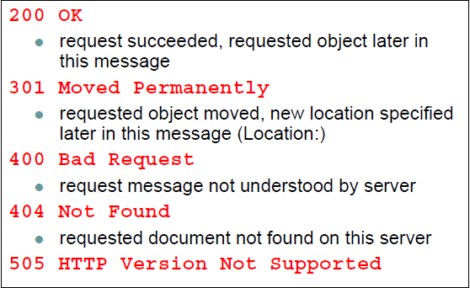
HTTP Response codes

Slide 19
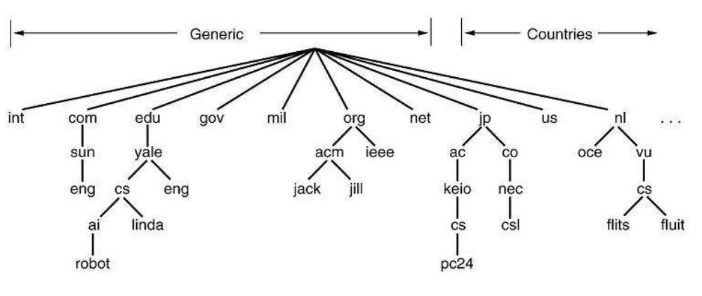
Domain name
The Domain Name System is a hierarchical naming system for computers, services, or any resource participating in the Internet
Example of domain name
  www.keio.ac.jp
  www.hedspi.hut.edu.vn
  .hut.edu.vn

Slide 20
Domain name
Domain Name Service (DNS) map a domain name with an IP address
Domain name
  Variable length
  Easy to memory by human being
  Independent of geographical location of a machine
IP address
  Fixed length
  Easy to be processed by computer
  Related to routing matter
203.162.7.194
www.hedspi.hut.edu.vn
www.hut.edu.vn
202.47.142.40

Slide 21



Example of DNS in web system
User
I want to access to
www.hedspi.hut.edu.vn
1
2
3
Please access to
202.47.142.40
4
Máy chủ tên
miền
Web server
202.47.142.40

Slide 22
URL
Uniform Resource Locator (URL) is a type of Uniform Resource Identifier (URI) that specifies where an identified resource is available and the mechanism for retrieving it
Format:
  protocol: name of site/main document#fragment identifier
  Ex: http://www.fit.hut.edu.vn/nhansu.htm
Two types of URLs:
  Absolute URL: full Internet address including the protocol, network location, and optional path and file name.
    Ex: http://www.microsoft.com
  Relative URL: URL with one or more of its parts missing. Browsers take the missing information from the page containing the URL.
    Ex: index.htm.

Slide 23
Character encoding
Character encoding
  Mapping of sequence of characters and a with something else for facilitating the transmission of data or storage in computers
    sequence of natural numbers, octets or electrical pulses
Unicode
  a computing industry standard allowing computers to consistently represent and manipulate text expressed in most of the world's writing systems.
  More than 100,000 characters
In Japan, 4 different encodings (Unicode, ISO-2022-JP, EUC-JP, Shift-JIS).
  Some web pages do not have the encoding specification →web browsers must guess the right encoding for such pages.

Slide 24
Character encoding
Unicode defines two mapping methods:
  Unicode Transformation Format (UTF) encodings
    UTF-8: 8 bits in one code value
    UTF-16: 16 bit in one code value
    UTF-32: 32 bit in one code value
  Universal Character Set (UCS) encodings
    UCS-2 is an obsolete subset of UTF-16;
    UCS-4 and UTF-32 are functionally equivalent.

Slide 25
Character Encoding
Many character encoding standards, such as ISO 8859 series, the encoding is straightforwardly related to the scalar position of the characters in the coded character set.
  Ex: letter A in the ISO 8859-1 is 65th character in coded set → is encoded by 65.
For Unicode,
  there isn't a trivial, one-to-one mapping coded character set value ←→ encoded value.
  There are a number of ways of encoding the same character.
  For example, the letter à can be represented by two bytes in one encoding and four bytes in another.
UTF-8 uses
  1 byte for characters in the ASCII set,
  2 bytes for characters in several more alphabetic blocks,
  3 bytes for the rest of the BMP.
  4 bytes for supplementary characters.
UTF-16 uses
  2 bytes for any character in the BMP,
  4 bytes for supplementary characters.
UTF-32 uses 4 bytes for all characters.

Slide 26
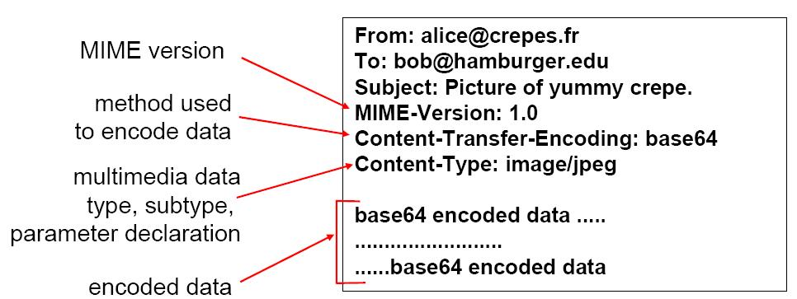
Media type
Multimedia Internet MEdia : MIME
  Text, Image, Audio, Video
Transmission of media type in HTTP message
  HTTP requires that data be transmitted in the context of e-mail-like messages, even though the data may not actually be e-mail.

